Slide 1
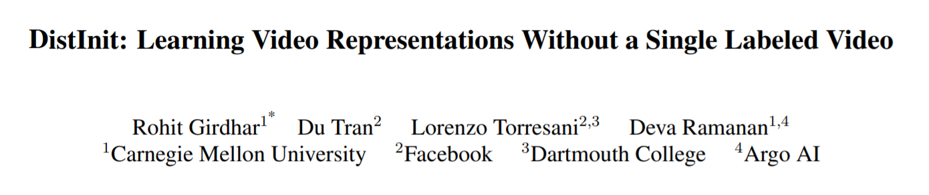
http://openaccess.thecvf.com/content_ICCV_2019/papers/Girdhar_DistInit_Learning_Video_Representations_Without_a_Single_Labeled_Video_ICCV_2019_paper.pdf

Slide 2
Introduction
Deep learning is transformative like ImageNet pre-training
Performance gains of video classification come from more data
Work on unlabeled, uncurated videos
What are the “right” labels for a video?
How do we transfer the knowledge encoded in image datasets into video models?

Slide 3
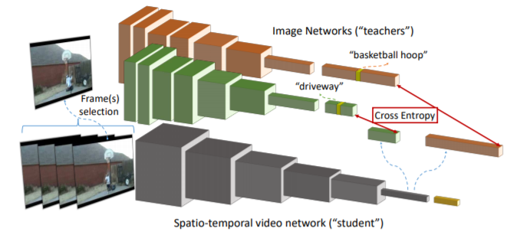
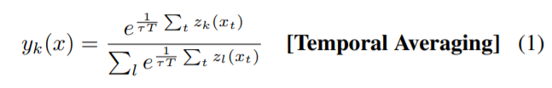
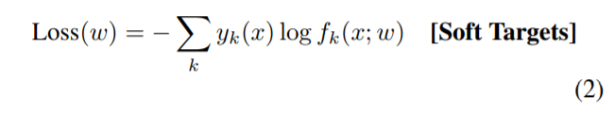

DistInit

Slide 4
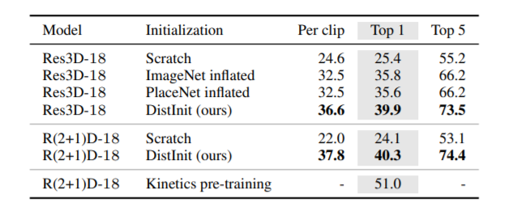
Results
Inflation: inflating 2D kernels to 3D via replication over time

Slide 5
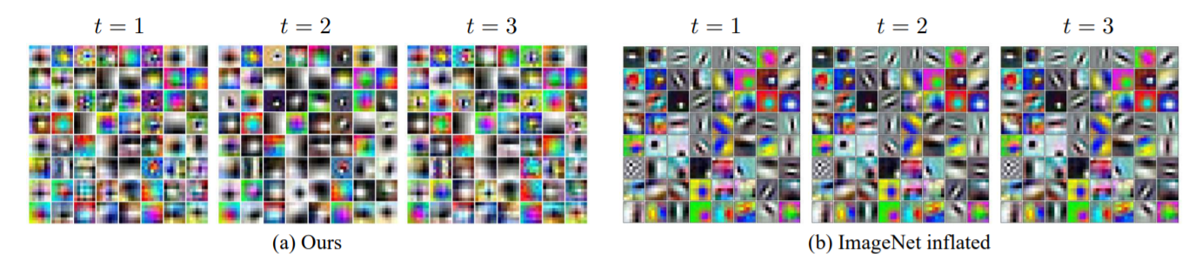
Visulaization

Slide 6
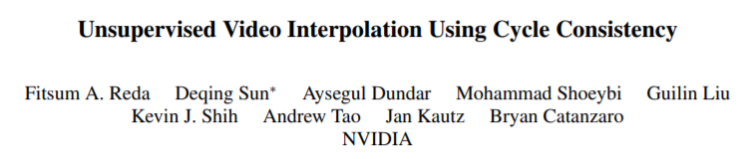
http://openaccess.thecvf.com/content_ICCV_2019/papers/Reda_Unsupervised_Video_Interpolation_Using_Cycle_Consistency_ICCV_2019_paper.pdf

Slide 7
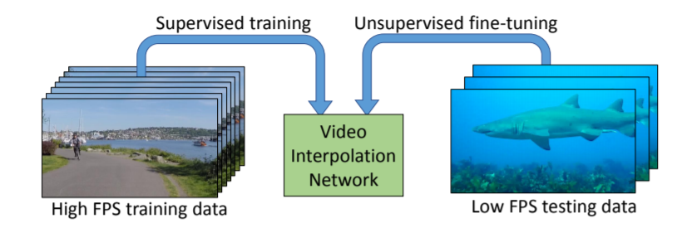
Introduction
High FPS looks smoothly
Out-of-domain, which means poor generalization

Slide 8
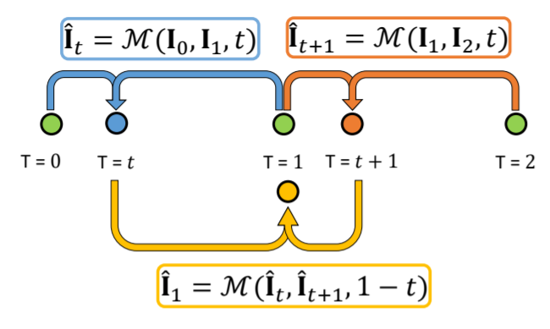

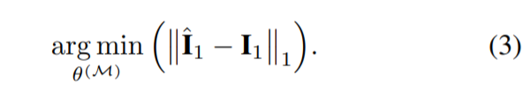

Slide 9
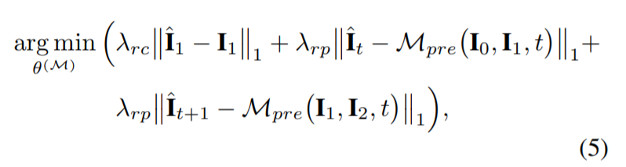
Pseudo loss
Use a pretrained model on B to regularize the training on A

Slide 10
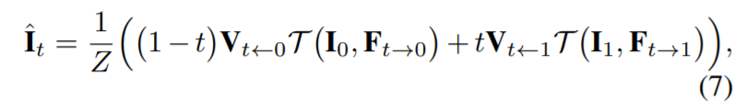


Super SloMo model
https://arxiv.org/pdf/1712.00080.pdf
Visible map
Optical flow from t to 0
Use Image and optical flow to warp

Slide 11

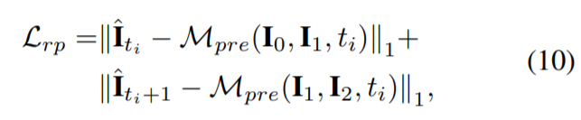

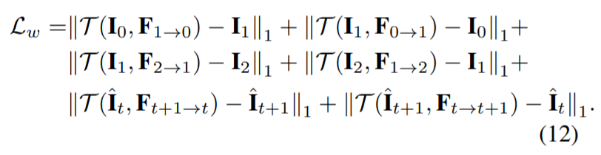
Over losses
Vgg loss

Slide 12
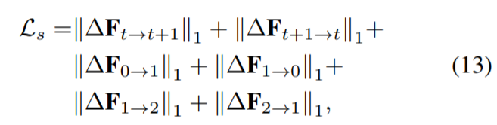
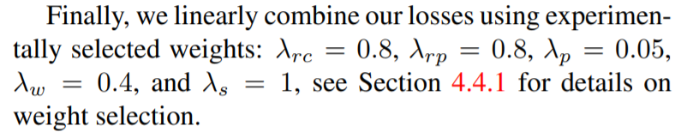
Over losses

Slide 13
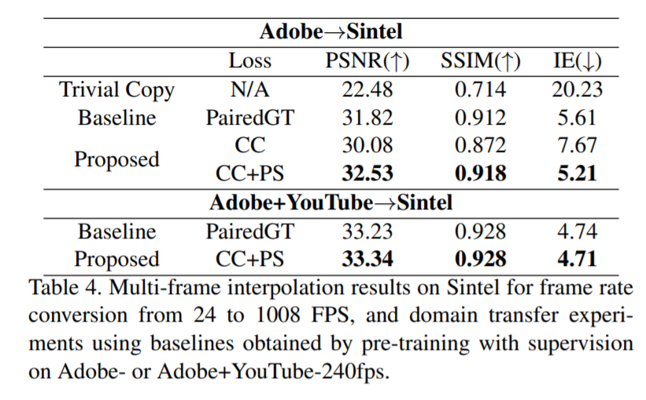
result

